Slide 1
Consumer Finance
Complaint Product Classification
Hong Yang, Haifeng Lin
December 2019
Notes:
‹#›
‹#›

Slide 2
Introduction
Objective: Use NLP to classify consumer complaint text into product categories
Data Source: Consumer Complaint Database
Application Areas:
Businesses can automatically send complaint to right team for quicker resolution
Businesses can quickly receive customer feedback and evaluate performance of their products & services
Can also apply to education and other areas

Slide 3
Approach
Prework - grouping labels and data cleansing
Baseline - LSTM
Model 1 - Attention sequence-based classification model
Model 2 - LSTM with Attention

Slide 4
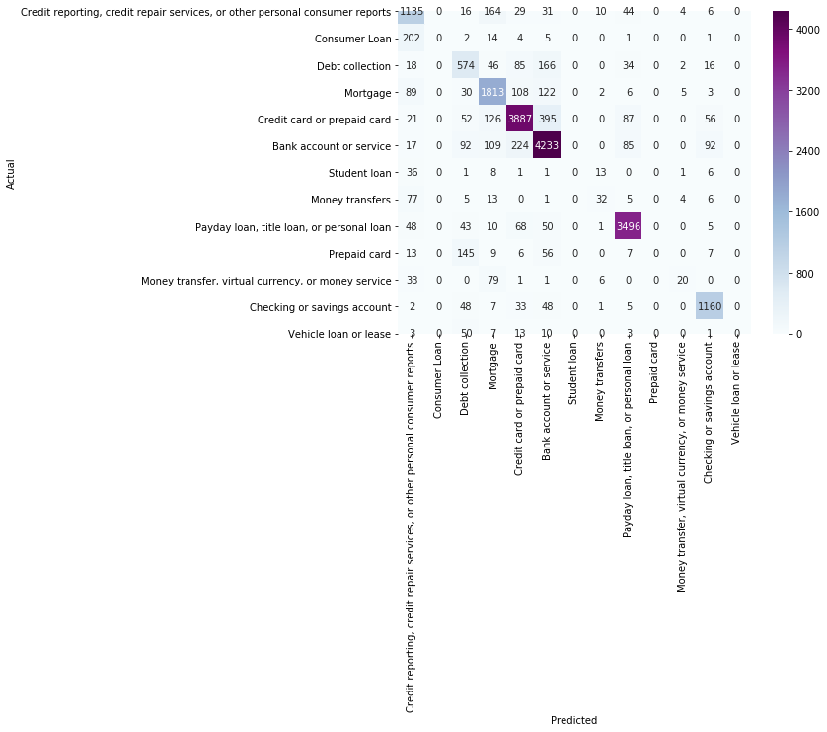
Baseline Model and Result
Recurrent Neural Network (RNN) using the Long Short Term Memory (LSTM) architecture
Overall decent accuracy of 82%
Lower Macro Average Precision of 50%
Product categories with fewer data points don’t produce any correct prediction.
This model does well on product categories that have massive amount of data points.

Slide 5
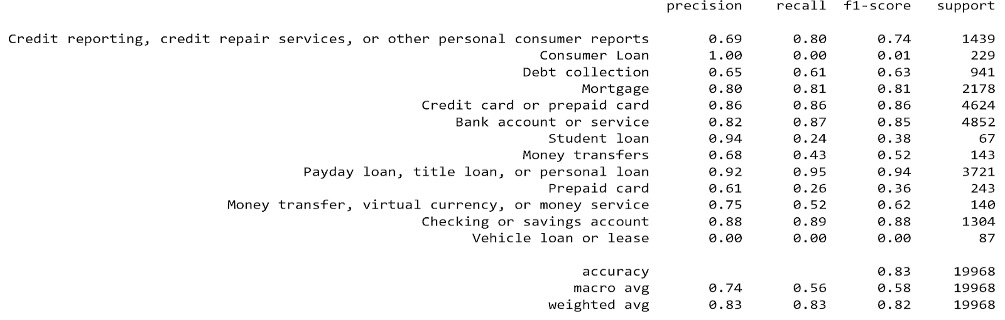
Model 1: Attention sequence-based classification model
Replaced LSTM layer with attention as Multi Headed attention model that used the embedding directectly to generate keys, value and queries.
Over accuracy of 83%
Much improved Macro Average Precision of 74%

Slide 6
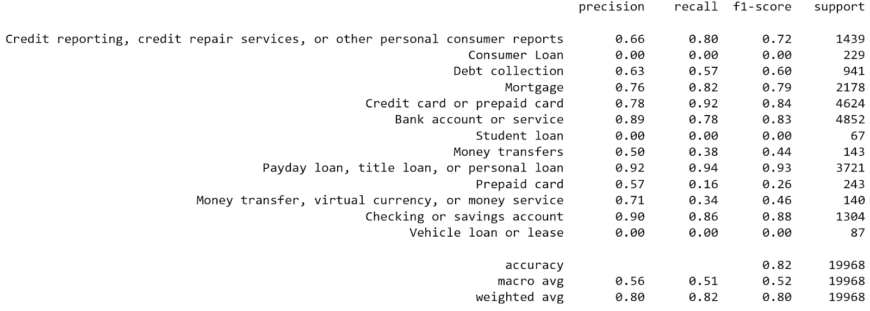
Model 2: LSTM with Attention
Replaced LSTM layer with attention as Multi Headed attention model that used the embedding directectly to generate keys, value and queries.
Over accuracy of 82%
Much improved Macro Average Precision of 56%

Slide 7
Model Comparison
For model 2, a high level of precision is achieved for the highly populated classes, at the expense of the less populated classes.
Model 1 performs better across the broader set of classes, but is not achieved the level of performance on the highly populated classes as model 2 does.
In general, this makes model 1 feels more mature model because it is further away from the trivial approach of assigning everything to the most populated class.

Slide 8
Conclusion
Overall accuracy is pretty high
Struggle to improve accuracy for products with few data points
Attention works better than LSTM alone
We could try other models if time permits
Multi-headed Attention
BERT

Slide 9
Reference
Paper Link:
https://github.com/hong6us/W266_Fall2019_FinalProject/blob/master/Consumer%20Finance%20Complaint%20Product%20Classification.pdf
Python Code: https://github.com/hong6us/W266_Fall2019_FinalProject/blob/master/Customer_Complaints_Analysis.ipynb
Data Source:
https://www.consumerfinance.gov/data-research/consumer-complaints/

